Slide 1
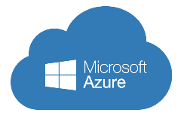
Implementing Microsoft Azure Infrastructure Solutions
Data & Cloud Skill Up and Exam Ready Workshop
WiFi: MSFTGUEST
Password: msevent73ew
Content Location: https://github.com/guruskill/70-533
Notes:
Access codes for wifi should be provided on site

Slide 2
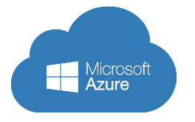

Day 1 – Date
Agenda
8:30 AM |  | Registration & Breakfast
8:45 AM |  | Welcome
9:00 AM |  | Agenda Overview
9:15 AM |  | Implement Virtual Networks
10:30 AM |  | Break
10:45 AM |  | Create and Manage Compute Resources
12:00 PM |  | Labs / Lunch / Networking
1:00 PM |  | Design and Implement Azure App Service Apps
2:15 PM |  | Break
2:30 PM |  | Design and implement a Storage Strategy
3:30 PM |  | Hands-On Labs (on-site and take home)
Notes:
Tentative Agenda

Slide 3
Day 2 – Date
Agenda
9:00 AM |  | Registration & Breakfast
9:30 AM |  | Planning and implementing Azure SQL Database
10:30 AM |  | Break
10:45 AM |  | Implementing PaaS cloud services
11:30 AM |  | Lab
12:00 AM |  | Implementing Azure Active Directory
1:00 PM |  | Implementing Azure-based management and automation
2:30 PM |  | Break
2:45 PM |  | Q&A: How will you use what you have learned
3:30 PM |  | Hands-On Labs
4:30 PM |  | Wrap-Up
Notes:
Tentative Agenda

Slide 4


Hello! Instructor introduction
Instructor: Richard Doelker
MCP, MCSA, MCSE, MCT
MSTS
Over 10 years of experience in the IT Field. BI Analyst for Scotiabank for 7 years, 2 years as a Trainer
Notes:
Welcome students to the course and introduce yourself. Provide a brief overview of your background to establish credibility.

Slide 5
Hello! Student introductions
Let’s get acquainted:
Your name
Company affiliation
Title/function
Windows Server 2012 experience
Microsoft Azure or cloud services experience
Your expectations for the course
Notes:
Ask students to introduce themselves and provide their backgrounds, product experience, and expectations for the course.
Record student expectations on a whiteboard or flip chart that you can reference during class.

Slide 6


Facilities
Class hours
Building hours
Parking
Restrooms
Meals
Phones
Messages
Smoking
Internet access
Recycling
Emergency procedures
Notes:
Explain class and facility logistics, using the bulleted list. Inform students about any emergency procedures, such as emergency exits, and plans in the event of fire or other emergencies.

Slide 7
About this course: Audience
Candidates who attend this course typically are IT professionals who:
Want to deploy, configure, and administer services and virtual machines (VMs) in Microsoft Azure
Have used Microsoft System Center to manage and orchestrate a Microsoft server infrastructure
Want to use Windows Azure to host websites and mobile app back-end services
Are experienced in other non-Microsoft cloud technologies, meet the course prerequisites, and are looking to cross-train on Microsoft Azure
Want to take the Microsoft Certification exam, 70-533, “Implementing Microsoft Azure Infrastructure Solutions”
Windows Server administrators who are looking to evaluate and migrate on-premises Active Directory roles and services to the cloud
Engineers who have used DevOps approaches to optimize the management and lifecycle of the software in their organization
Notes:
Describe the audience for this course. This is an opportunity for you to identify students who may not have the appropriate background or experience to attend the course.

Slide 8
About this course: Prerequisites
Before attending this course, students must have:
Basic understanding of cloud technologies and Microsoft Azure
Working knowledge of Active Directory Domain Services
Working knowledge of on-premises virtualization technologies
Understanding of networking concepts and technologies
Understanding of websites and web applications
Understanding of database concepts
Understanding of resilience and disaster recovery
Notes:
Describe the course prerequisites.

Slide 9
About this course: Objectives
After completing this course, students will be able to:
Describe Azure architecture components including infrastructure, tools, and portals
Implement and manage virtual networking within Azure, and connect to on-premises environments
Plan and create Azure VMs
Configure, manage, and monitor Azure VMs to optimize availability and reliability
Deploy and configure web apps and mobile apps
Implement, manage, back up, and monitor storage solutions
Plan and implement data services based on SQL Database to support applications
Deploy, configure, monitor, and diagnose cloud services
Create and manage Azure Active Directory (Azure AD) tenants, and configure application integration with Azure AD
Integrate on-premises Windows AD with Azure AD
Automate operations in Azure management by using automation

Slide 10
Introduction to cloud computing
Characteristics of cloud computing solutions:
On-demand self-service
Broad network access
Resource pooling
Rapid elasticity
Measured service
Notes:
Note: This topic has one additional slide.
Define cloud computing, and compare cloud computing to on-premises computing. List the advantages of cloud computing (scalability, availability, elasticity), and compare public, private, and hybrid clouds.
20533C
1: Introduction to Microsoft Azure

Slide 11
Introduction to cloud computing
Public, private, and hybrid clouds
A public cloud is an infrastructure, platform, or application service that a cloud service provider delivers for access and consumption by the public
A private cloud is a privately owned and managed cloud that offers benefits similar to those of a public cloud, but is designed and secured for use by a single organization
A hybrid cloud is a technology that binds two separate clouds—public and private—together for the specific purpose of obtaining resources from both
Notes:
20533C
1: Introduction to Microsoft Azure

Slide 12
Types of cloud services
SaaS
A complete
software solution
PaaS
A platform of services for hosting a custom solution
IaaS
A way to run virtual servers in the cloud with full control
Notes:
Use the following examples of Software as a Service (SaaS), Platform as a Service (PaaS), and Infrastructure as a Service (IaaS) services, and ask the students to suggest others:
Microsoft Office 365. This service is a good example of a SaaS offering. It offers a complete software app that Microsoft delivers through the cloud.
Azure Web apps and Azure SQL Database. These services are good examples of PaaS services. They both offer a platform for building application solutions (a website and a relational database, respectively) but do not require any configuration and management at the underlying operating-system level.
Note: Sometimes SQL Database is described as a Database as a Service offering, which is a specific subset of PaaS for database management solutions.
Azure Virtual Machines. This service is a good example of an IaaS solution. It enables you to host servers in the cloud with full control over the operating system and virtual hardware.
Identify the continual evolution of various IT functions into packaged services, such as Identity as a Service (IDaaS) and Disaster Recovery as a Service (DRaaS).
20533C
1: Introduction to Microsoft Azure

Slide 13
Understanding Azure datacenters
Azure datacenters are located in the following geographic areas:
West Europe
East Asia
Central US
East US
East US 2
West US
North Central US
South Central US
North Europe
Southeast Asia
Japan West
Japan East
Brazil South
Australia East
Australia Southeast
South India
Central India
West India
Notes:
Note: This topic has one additional slide.
The details of Azure datacenter architecture and cluster implementation are interesting for IT professionals, and an understanding of how Azure is implemented is beneficial when planning and implementing Azure services. The key point at this stage is that students and organizations can be assured that Azure datacenters are designed to provide a highly resilient, scalable, and security-enhanced platform for cloud infrastructure and apps.
20533C
1: Introduction to Microsoft Azure

Slide 14
Understanding Azure datacenters
Global distribution
Management by Microsoft
Modular architecture:
Clusters of thousands of servers in pluggable units
Full power redundancy and contingency
High-speed, redundant intra-datacenter networks
High-speed inter-datacenter and Internet connectivity
Triple-redundant data storage and geo-replication
High power and water efficiency
Servers that run Windows Server
Azure Service Fabric
Notes:
20533C
1: Introduction to Microsoft Azure

Slide 15
Understanding the Azure service model
Azure is a pay-per-use, multi-tenant service
The purchase options are:
Pay-As-You-Go
Annual subscription
Microsoft reseller
Enterprise Agreement
Azure Compute Option
The support options are:
Developer
Standard
Professional Direct
Premier
Notes:
Explain the basic service model for Azure. List and explain the pricing options and provide details about the available support plans. You can research the current costs for the purchase and support plans by using the links in the student handbook prior to presenting this topic.
20533C
1: Introduction to Microsoft Azure

Slide 16
Understanding other Azure resources
Azure Marketplace: certified, open source, and community apps, and developer services
VM Depot: community-provided virtual machine images based on open source operating systems
GitHub: APIs, SDKs, and open source projects
Azure Trust Center: information and guidance around security, privacy, and compliance
Notes:
Explain the Azure Marketplace, the VM Depot, GitHub, and the Azure Trust Center.
20533C
1: Introduction to Microsoft Azure

Slide 17
Azure management tools
Azure portals
Windows PowerShell
Azure Automation
Azure CLI
Visual Studio
Notes:
Introduce the tools and their primary purposes.
20533C
1: Introduction to Microsoft Azure

Slide 18
Implementing and managing Azure networking
Notes:
Presentation: 90 minutes
Labs: 65 minutes
After completing this module, students will be able to:
Plan virtual networks in Microsoft Azure (Azure).
Implement and manage virtual networks.
Configure intersite connectivity with virtual networks in Azure.
Configure networking components.
Plan virtual networks in infrastructure as a service (IaaS) version 1 (v1).
Required materials
To teach this module, you need the Microsoft PowerPoint file 20533C_02.pptx.
Preparation tasks
To prepare for this module, you should:
Read all of this module’s materials.
Practice performing the demonstrations and labs.
Work through the Module Review and Takeaways section to determine how you will use the information to reinforce student learning and promote knowledge transfer to on-the-job performance.
As you prepare for this class, it is imperative that you complete the labs yourself. This gives you an understanding of how the labs work and the concepts that each covers, so that you can provide meaningful hints to students who might have issues. Furthermore, it will help guide your lecture to ensure that you discuss the concepts that the labs cover.
20533C
2: Implementing and managing Azure networking
(More notes on the next slide)

Slide 19
Azure networking components
Compute
Networking
Data & Storage
Web & Mobile
Virtual Network
Service Fabric
Azure DNS
Container Service
Storage
Application Gateway
Web Apps
DocumentDB
Azure Virtual Machines
Traffic Manager
Mobile Apps
Azure SQL Database
ExpressRoute
Azure Cloud Services
Notification Hub
Load Balancer
StorSimple
Other services
Service Bus
Automation
Azure AD
Scheduler
Azure AD DS
Azure Backup
Key Vault
MFA
Site Recovery
Azure Security Center
Notes:
Note: This topic has one additional slide.
Use this slide to orientate students for this module. They saw this same slide in the topic Understanding Azure services in Module 1. However, the primary subject of this module, networking, has been highlighted in red. Closely-related subjects that are mentioned in this module have been highlighted in orange.
Note: This slide does not represent all the available Azure service offerings.
20533C
2: Implementing and managing Azure networking

Slide 20
Azure networking components
VNets
IP addresses:
Private IP addresses
Public IP addresses
Subnets
Network interfaces
DNS
Azure load balancer and internal load balancer
Application gateway
Traffic Manager
Network Security Groups
User-defined routes
Forced Tunneling
Regional VNets
Cross-premises network connectivity
A Point-to-Site VPN
A Site-to-Site VPN
ExpressRoute
Notes:
Use this first topic as an introduction to the networking features in Azure. Do not spent lot of time to explain individual features, because other topics cover networking functionality in more detail.
20533C
2: Implementing and managing Azure networking

Slide 21
Overview of Azure virtual networks
Azure
Local Network
Virtual network
VM
VPN
Notes:
Note: This topic has one additional slide
Azure virtual networks can function as part of the on-premises network, you can achieve this by using virtual private networks (VPNs), for example. In this topic, the most important thing is to explain IP address allocation and name resolution. Emphasize that you also should plan to implement virtual networks before deploying Azure VMs.
20533C
2: Implementing and managing Azure networking

Slide 22
Overview of virtual networks
VNet features:
Azure Resource Manager deployment model:
Private IP addresses, allocated to a NIC
Public IP addresses, allocated to a NIC or a load balancer
Azure Classic deployment model:
Dynamic IP addresses, allocated to a VM
Virtual IP addresses, allocated to a cloud service
Public instance-level IP addresses, allocated to a VM
IP addressing in VNets
Subnets
DNS
Cross-premises network connectivity
Notes:
Prepare to discuss some questions about differences between the classic and the ARM deployment models. Emphasize that Microsoft recommends the use of the ARM model, but not all the features are fully developed in ARM, such as point-to-site VPN connection. Again there are lot of information in this topic and is important that you use this only as an introduction to the features, without explaining each feature in detail.
20533C
2: Implementing and managing Azure networking

Slide 23
Overview of network interfaces
NIC:
Assign to a VM
Assign to a load balancer backend pool
IP address configuration:
Private IP addresses with dynamic and static allocation
Public IP addresses with dynamic and static allocation
Multiple NIC configuration for VMs, or Virtual Appliance:
VM based on size D1 – single NIC
VM based on size D2 – two NICs
VM based on size D3 – four NICs
VM based on size D3 – eight NICs
Notes:
20533C
2: Implementing and managing Azure networking

Slide 24
Overview of private IPs
Private IP address allocation:
Dynamic
Static
Adding a static private IP address:
$vnet = Get-AzureRmVirtualNetwork -ResourceGroupName AdatumRG -Name AdatumVNet
$subnet = $vnet.Subnets[0].Id
$nic = New-AzureRmNetworkInterface -Name AdatumNIC -ResourceGroupName AdatumRG -Location centralus -SubnetId $vnet.Subnets[0].Id -PrivateIpAddress 192.168.0.10
Add-AzureRmVMNetworkInterface -VM $vm -Id $nic.Id
Notes:
20533C
2: Implementing and managing Azure networking

Slide 25
Overview of load balancers
Azure load balancer:
Internal load balancer
Internet-facing load balancer
Application gateway
Traffic Manager
Configuring Azure load balancer:
Configure front-end IP
Configure backend address pool
Create load-balancing rules
Create health probes
Create inbound NAT rules
Notes:
20533C
2: Implementing and managing Azure networking

Slide 26
Overview of Azure DNS
Creating an Azure DNS zone:
Select the subscription: Select-AzureRmSubscription –SubscriptionName <Name of your subscription>
Create a new resource group: New-AzureRMResourceGroup –Name AdatumRG –Location centralus
Create a DNS Zone: New-AzureRmDnsZone -Name adatum.com -ResourceGroupName AdatumRG
Retrieve SOA and NS records for the zone: Get-AzureRmDnsRecordSet -ZoneName adatum.com –ResourceGroupName AdatumRG
Create a resource record: New-AzureRmDnsRecordSet -Name "www" -RecordType "A" -ZoneName "adatum.com" -ResourceGroupName "AdatumRG" -Ttl 60
Notes:
Use Azure DNS to host your Domain Name System (DNS) domains in Azure. Manage your DNS records using the same credentials, and billing and support contract, as your other Azure services. Seamlessly integrate Azure-based services with corresponding DNS updates and streamline your end-to-end deployment process.
20533C
2: Implementing and managing Azure networking

Slide 27
Planning for Azure virtual networks
Choose both private and public non-overlapping address space
Choose subnets:
The first three IP addresses and the last IP address within each subnet are not available for use
The smallest subnets you can specify use 29-bit subnet masks
Use static, private IP addresses (optional)
Notes:
Explain that provided the students understand how to design subnets in on-premises environments, they should have minimal or no problems with designing subnets in Microsoft Azure.
Highlight the fact that Azure supports three private IPv4 subnet address spaces: one Class A (10.0.0.0/16), one Class B (192.168.0.0/16) and one in-between (172.16.0.0/12). Within those address spaces, you must create one or more subnets and select the number of hosts in each subnet. Remind students that you will lose four addresses for each subnet.
Point out to students that you should not use overlapping subnet ranges both on-premises and in Microsoft Azure. This is because hosts on each network will not be able to contact each other, and will not attempt to route the traffic through the default gateway.
Point out that currently IPv6 is not supported in Azure.
20533C
2: Implementing and managing Azure networking

Slide 28
Creating virtual networks by using the Azure portal
Sign in to the Azure Portal
In the navigation menu on the left, click New, select Networking, and then click Virtual Network
In the Virtual Network blade, verify that Resource Manager deployment model is selected, and then click Create
In the Create virtual network blade, in the Name text box, type a descriptive name for the VNet
In the Address space box, select an IP address range by using CIDR notation
In the Subnet name text box, type a descriptive name for the subnet
In the Subnet address range box, type the IP address range for the subnet using CIDR notation
In the Subscription box, select the right Azure subscription in which you want to create a virtual network
In the Resource group box, either create a new resource group or select an existing one
In the Location box, select a location near your users, and click Create
Notes:
The step-by-step procedure described in the student manual creates a cloud-only virtual network with no VPN or ExpressRoute connections. These connections can be added to the virtual network configuration later. Students will see these procedures in Lesson 4, and will configure them in the lab.
20533C
2: Implementing and managing Azure networking

Slide 29
Creating virtual networks by using PowerShell
Open Microsoft Azure PowerShell and sign in to your subscription
Select the subscription in which you plan to create a virtual network and configure Point-to-Site VPN
Create a new resource group
Create a new VNet and address space
Store the virtual object in a variable
Add a subnet to the variable
Set the configuration in the virtual network
Notes:
20533C
2: Implementing and managing Azure networking

Slide 30
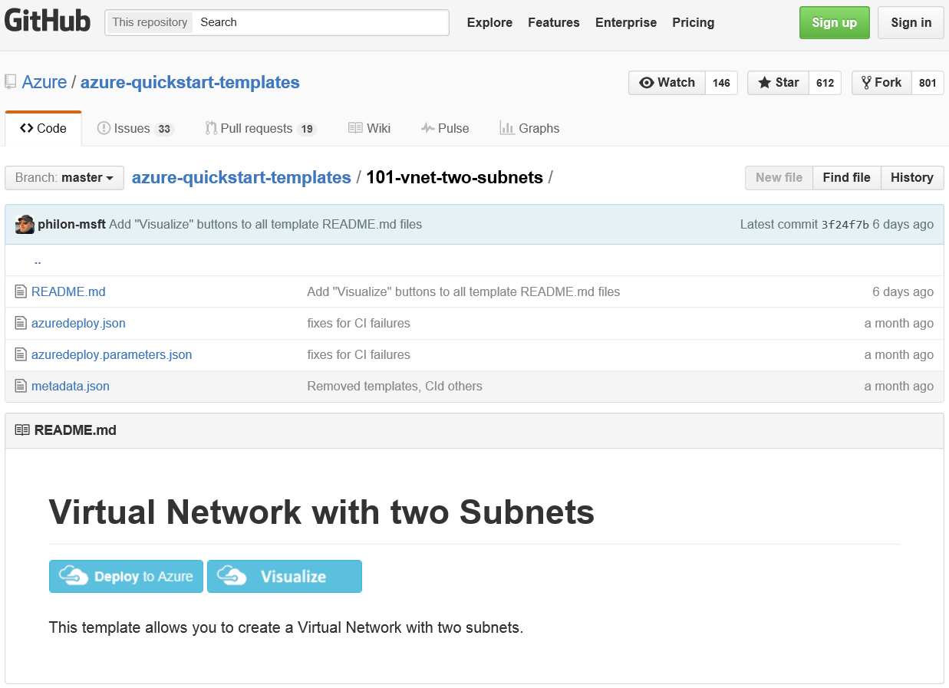
Creating a virtual network by using a deployment template
Notes:
20533C
2: Implementing and managing Azure networking

Slide 31

Configuring forced tunneling
On premises
Internet
Forced tunneled via S2S VPN
Directly to
Internet
S2S
VPNs
VPN
GW
Backend
10.3/16
Middle-tier
10.2/16
Front-end
10.1/16
Virtual Network
Notes:
Explain the slide briefly to demonstrate how forced tunneling can be used. Mention that you can selectively choose different subnets to apply different routing rules. On this slide, for example, we force traffic that originate from the backend and the middle-tier subnets to be sent in on-premises network through site-to-site VPN connection by using user defined routes with forced tunneling configuration.
20533C
2: Implementing and managing Azure networking

Slide 32
Configuring network security groups
Network security group rules consist of:
Name
Direction
Priority
Access
Source IP address prefix
Source port range
Destination IP address prefix
Destination port range
Protocol
Notes:
20533C
2: Implementing and managing Azure networking

Slide 33
Lesson 4: Configuring virtual network connectivity
Intersite connectivity options Configuring point-to-site VPN connectivity Configuring a site-to-site VPN Configuring a VNet-to-VNet VPN Connecting IaaS v1 virtual networks to IaaS v2 virtual networks
Notes:
20533C
2: Implementing and managing Azure networking

Slide 34
Intersite connectivity options
Azure
East US VNet
West US VNet
VNet-to-VNet
Point-to-site
Site-to-site
On-premises network
Notes:
Students have already learned about VPN connection options and ExpressRoute in Lesson 1. You either can use the current topic to discuss that information briefly, or you can cover connections in detail here.
Take the students through the three main intersite connectivity options. Use the whiteboard to explain to them that point-to-site is closest to a typical end user client VPN (which they most likely are more familiar with), whereas site-to-site sets up routing between the two sites across the VPN tunnel. Then highlight the differences in ExpressRoute.
Point-to-site. Direct VPN connection from client to Azure site. Can work with site-to-site connections, but not with ExpressRoute.
Site-to-site. Connection from a VPN device to an Azure VPN Gateway. Can work with point-to-site connections, and can use ExpressRoute.
VNet-to-VNet. Links virtual networks to form cross-region or cross-subscription connections. Only links up to 10 networks (virtual networks and on-premises sites). Redundant tunnels not supported.
Multi-site. Two site-to-site connections to virtual networks in two different regions. Must be configured with network configuration files.
ExpressRoute. Connection does not go over the public Internet. Increases speed, security, and reliability, and reduces latency. Only works with site-to-site connections.
20533C
2: Implementing and managing Azure networking

Slide 35
Connecting IaaS v1 virtual networks to IaaS v2 virtual networks
Create an ARM VNet
Create a classic VNet
Connect the classic and the ARM VNets
Notes:
Point out that this topic presents a high level overview of the steps required to connect to VNets created in the classic and the ARM model. Also mention, that participants will have a lab exercise where they will configure a connection between IaaS v1 VNet and IaaS v2 VNet.
20533C
2: Implementing and managing Azure networking

Slide 36
Lesson 5: Overview of Azure networking in IaaS v1
Overview of IaaS v1 virtual networks Connecting to virtual networks in IaaS v1 Implementing virtual networks in IaaS v1
Notes:
20533C
2: Implementing and managing Azure networking

Slide 37
Overview of IaaS v1 virtual networks
Cloud services and virtual machines
IP addresses:
DIP addresses
VIP addresses
Static IP addresses
Reserved IP addresses
Instance-level PIP addresses
DNS
Azure load balancer and internal load balancer
Traffic Manager
Notes:
20533C
2: Implementing and managing Azure networking

Slide 38
Connecting to virtual networks in IaaS v1
To connect VNets in IaaS v1, use:
Point-to-site
Site-to-site
VNet-to-VNet
Multisite
ExpressRoute
Notes:
20533C
2: Implementing and managing Azure networking

Slide 39
Implementing a virtual network in IaaS v1
From the Networks page, open the VNet Custom Create Wizard
Set the VNet name and select a region
Configure a DNS server if required
Configure IP address name spaces and subnets according to your plan
Notes:
Note: This topic has an additional slide.
20533C
2: Implementing and managing Azure networking

Slide 40
Implementing a virtual network in IaaS v1
Configuring a VNet by using a configuration file:
<VirtualNetworkSites>
<VirtualNetworkSite name="Main_Network" Location="East Asia">
<AddressSpace>
<AddressPrefix>192.168.0.0/16</AddressPrefix>
</AddressSpace>
<Subnets>
<Subnet name="Front-End Subnet">
<AddressPrefix>192.168.0.0/28</AddressPrefix>
</Subnet>
<Subnet name="Mid-Tier Subnet">
<AddressPrefix>192.168.0.16/29</AddressPrefix>
</Subnet>
<Subnet name="Back-End Subnet">
<AddressPrefix>192.168.0.24/29</AddressPrefix>
</Subnet>
</Subnets>
</VirtualNetworkSite>
</VirtualNetworkSites>
Notes:
20533C
2: Implementing and managing Azure networking

Slide 41
Implementing virtual machines
Notes:
Presentation: 90 minutes
Labs: 60 minutes
After completing this module, students will be able to:
Explain Infrastructure as a Service (IaaS) version 2 (v2) virtual machines (VMs).
Plan for Azure Virtual Machines.
Deploy IaaS v2 VMs.
Author Azure Resource Manager templates.
Explain IaaS version 1 (v1) virtual machines.
Required materials
To teach this module, you need the Microsoft PowerPoint file 20533C_03.pptx.
Preparation tasks
To prepare for this module, you should:
Read all of this module’s materials.
Practice performing the demonstrations and labs.
Work through the Module Review and Takeaways section to determine how you will use the information to reinforce student learning and promote knowledge transfer to on-the-job performance.
As you prepare for this class, it is imperative that you complete the labs yourself. This gives you an understanding of how the labs work, as well as the concepts that each lab covers. This enables you to provide meaningful hints to students who might have issues while working in the labs. Furthermore, it will help guide your lecture to ensure that you discuss the concepts that the labs cover.
20533C
3: Implementing virtual machines

Slide 42
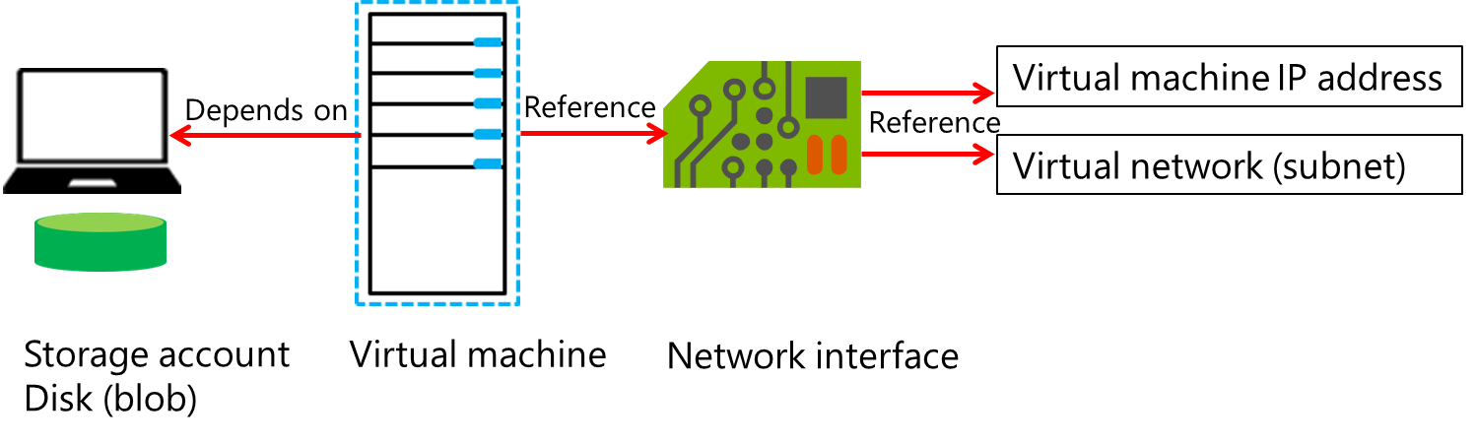
What are IaaS v2 virtual machines?
Notes:
Explain the IaaS v2 model, and explain how it affects Azure Virtual Machines. Focus primarily on the high-level concept of managing IaaS v2 VMs by using Azure Resource Manager, and explain the primary changes to virtual-machine management. It is important to point out that IaaS v2 enables you to create IaaS resources, independent of the Azure Cloud Services object that the Azure Service Management model uses. This allows for IaaS resources, such as network interfaces and storage, to be created, attached to, and detached from, virtual machines. Explain Azure Resource Manager templates and the functionality that they provide in the IaaS v2 model. You will cover templates in more detail later in this module.
20533C
3: Implementing virtual machines

Slide 43
Comparing IaaS v1 and IaaS v2 virtual machines
Service management model
Resource manager model
Compute
IaaS V1 VMs
IaaS V2 VMs
IaaS V1 VNet
Networking
IaaS V2 VNet
Data & Storage
IaaS V1 storage
IaaS V2 storage
Web & Mobile
Notes:
Identify the primary differences between IaaS v1 and IaaS v2. This course focuses on IaaS v2 implementation, so make that the focus when you discuss features. Explain the difference between the primary operating models--Azure Service Management versus Azure Resource Manager--and how you implement each. Use the tables in the content to highlight the key conceptual differences between IaaS v1 and IaaS v2.
20533C
3: Implementing virtual machines

Slide 44
Identifying workloads for Azure Virtual Machines
Suitable workloads for Azure Virtual Machines:
Highly available service workloads
Periodic, unpredictable growth, or spiking workloads
Steady workloads
Unsuitable workloads for Azure Virtual Machines:
Low volume or limited growth workloads
Regulated environment workloads
Consider PaaS alternatives to virtual machines
Software support for Azure Virtual Machines
Windows Server roles
Other server products (SQL, SharePoint, System Center)
Linux distributions
Notes:
Identify workloads that are both suitable and unsuitable for Azure Virtual Machines. Review the Windows Server roles and features that have special considerations for Azure Virtual Machines. Provide guidance about Platform as a Service (PaaS) services that you can substitute for certain Windows Server roles, and how a PaaS service is a better choice due to the highly available and scalable nature of PaaS services.
20533C
3: Implementing virtual machines

Slide 45
Virtual machine sizing
Virtual machine sizes for Azure:
A-series
D-series
G-series
DS and GS series
Sizing considerations:
The size of a VM affects pricing
A1 is the smallest size that we recommend for production workloads
The Microsoft Azure (IaaS) Cost Estimator Tool:
Performs a 15-minute scan of hardware and resources
Matches the resulting server profile to Azure IaaS instances
Provides a 30-day cost estimate for running each instance
Notes:
Explain the sizing levels, using the content and the links provided in the student handbook. Explain the Basic and Standard tiers, and the primary differences. Explain the Microsoft Azure (IaaS) Cost Estimator Tool, and explain how you can use it to assess an on-premises infrastructure prior to migrating workloads to Azure.
20533C
3: Implementing virtual machines

Slide 46
Migrating workloads to Azure
When uploading virtual machines to Azure, remember that:
VHD files must be from Hyper-V virtual machines
.VHDX files are not supported
You must generalize the on-premises virtual machine by using sysprep.exe
The .VHD file must be a fixed size virtual disk
Notes:
Identify the factors and general steps for uploading a virtual machine so that an Azure virtual machine can use it.
20533C
3: Implementing virtual machines

Slide 47
Evaluating the use of Azure containers
Feature | Virtual machines | Containers
Default security support | Greater control of security mechanisms. | Lesser control, but easier implementation.
Memory on disk required | Required for complete operating system and apps. | Required for apps only.
Startup time | Increased startup time. Boot of operating system, services, and apps. | Lesser startup time. Only apps and dependent services start. Kernel is already running.
Portability | Portable with proper configuration. | More portable, typically smaller in storage size.
Image automation | Dependent on operating system and apps. | Based on docker registry.
Notes:
Explain containers at a high level, describing the fundamental concepts to students. Identify the purpose for containers, and the key differences between containers and virtual machines.
20533C
3: Implementing virtual machines

Slide 48
Creating IaaS v2 virtual machines
Tools
Azure portal
Azure PowerShell
Azure CLI
Create Azure Virtual Machines from a blank VHD or by using images, including:
By capturing virtual machines
From the Azure Marketplace
Notes:
Identify the primary tools and methods that you can use to create virtual machines in Azure. Focus at a high level on the Azure portal and the Azure PowerShell methods, because later topics provide more detail on these. You can provide more detail around Azure command-line interface (Azure CLI) and capturing images. A later section of this module provides more detail about deploying images.
20533C
3: Implementing virtual machines

Slide 49
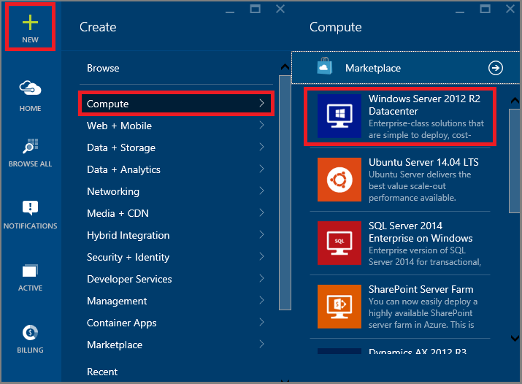
Using the Azure portal to create virtual machines
Notes:
Explain the process for creating a virtual machine by using the Azure portal. You will demonstrate this process later in this lesson.
20533C
3: Implementing virtual machines

Slide 50
Using Azure PowerShell to create virtual machines
Create a new IaaS v2 virtual machine in Azure PowerShell by using the New-AzureRmVM cmdlet
$vm = New-AzureRmVMConfig -VMName WindowsVM -VMSize "Standard_A1"
$vm = Set-AzureRmVMOperatingSystem -VM $vm -Windows -ComputerName MyWindowsVM -Credential $cred -ProvisionVMAgent -EnableAutoUpdate
$vm = Set-AzureRmVMSourceImage -VM $vm -PublisherName MicrosoftWindowsServer -Offer WindowsServer -Skus 2012-R2-Datacenter -Version "latest"
$vm = Add-AzureRmVMNetworkInterface -VM $vm -Id $nic.Id
$osDiskUri = $storageAcc.PrimaryEndpoints.Blob.ToString() + "vhds/WindowsVMosDisk.vhd"
$vm = Set-AzureRmVMOSDisk -VM $vm -Name "windowsvmosdisk" -VhdUri $osDiskUri -CreateOption fromImage
New-AzureRmVM -ResourceGroupName $rgName -Location $locName -VM $vm
Notes:
Explain the steps that are required to create a new virtual machine by using the Azure Resource Manager cmdlets in Azure PowerShell.
20533C
3: Implementing virtual machines

Slide 51
Creating virtual machines by using a deployment template
Deploy the contents of a template by using the following command:
New-AzureRmResourceGroupDeployment -Name <DeploymentName>-ResourceGroupName <ResourceGroupName -TemplateUri <TemplateUri>
Notes:
Explain the steps that are required to create a new virtual machine in Azure PowerShell by using Azure Resource Manager templates.
20533C
3: Implementing virtual machines

Slide 52
Azure Resource Manager templates overview
When creating and working with resource templates, consider:
Which resources you are going to deploy
Where your resources will be located
Which version of the resource provider API you will use
Whether there are dependencies between resources
When you will define deployment values (in the template before creation or during deployment)
If you want to retain deployment information or values
In its simplest form, the resource template looks like the code sample below:
{
"$schema": "http://schema.management.azure.com/schemas/2015-01-01/deploymentTemplate.json#",
"contentVersion": "",
"parameters": { },
"variables": { },
"resources": [ ],
"outputs": { }
}
Notes:
Explain the main components of the Azure Resource Manager template and the function of each. Use the complete template-code sample to show students the syntax and examples for each template section.
20533C
3: Implementing virtual machines

Slide 53
Modifying Azure Resource Manager templates
Azure Resource Manager template components:
Parameters
Variables
Resources
Outputs
Azure Resource Manager template functions types:
Numeric
String
Array
Deployment value
Resource
Notes:
Explain the syntax and construction of the different components of the Azure Resource Manager template. Explain the purpose and general categories for template functions. Note that the composition and specifics of template operations is a complex topic, and the details of each individual function are outside the scope of this course.
20533C
3: Implementing virtual machines

Slide 54
Managing virtual machines
Notes:
Presentation: 85 minutes
Lab: 60 minutes
After completing this module, students will be able to:
Configure virtual machines.
Configure virtual machine disks.
Manage and monitor virtual machines.
Required materials
To teach this module, you need the Microsoft PowerPoint file 20533C_04.pptx.
Preparation tasks
To prepare for this module, you should:
Read all of this module’s materials.
Practice performing the demonstrations and labs.
Work through the Module Review and Takeaways section to determine how you will use the information to reinforce student learning and promote knowledge transfer to on-the-job performance.
As you prepare for this class, it is imperative that you complete the labs yourself. This gives you an understanding of how the labs work and the concepts that each covers, so that you can provide meaningful hints to students who might have issues. Furthermore, it will help guide your lecture to ensure that you discuss the concepts that the labs cover.
20533C
4: Managing virtual machines

Slide 55
Configuring virtual machine availability
Availability set:
Logical grouping of two or more virtual machines
Update domain:
Separate Azure infrastructure grouped by update cycle
Fault domain:
Separate Azure infrastructure grouped by hardware resources
Considerations:
Add multiple virtual machines to availability sets
Place application tiers in separate availability sets
Combine availability sets with load balancing
Notes:
Note: This topic has one additional slide.
Explain how availability sets allow for greater availability of virtual machines that use the same or similar configurations. Explain the concept of fault domains and update domains in the context of availability sets. Identify the considerations for configuring availability sets.
20533C
4: Managing virtual machines

Slide 56
Configuring virtual machine availability
Fault Domain 0
Fault Domain 1
Fault Domain 2
Update
Domain 0
Update
Domain 1
Update
Domain 2
Notes:
Use this slide to illustrate the distribution of VMs across fault domains and update domains.
20533C
4: Managing virtual machines

Slide 57
Configuring virtual machine scalability
VM Scale Sets provide scalability of Azure IaaS v2 virtual machines:
Implement by using Azure Resource Manager templates or REST API
Integrate VM scale sets with:
Azure Insight autoscale
Load Balancer
NAT rules
Notes:
Note: This topic has one additional slide.
Introduce and describe VM scale sets in Azure. Explain that scale sets are implanted by using Azure Resource Manager templates, and therefore are only available when deploying IaaS v2 virtual machines. Point out the key components of a scale set configuration in Azure Resource Manager templates.
20533C
4: Managing virtual machines

Slide 58
Configuring virtual machine security
Azure uses industry standard encryption for data sent to, received from, and travelling within Azure datacenters
Azure Key Vault
Store secret data and keys
Use secret data and keys in Azure management and config
Azure Drive Encryption
Full volume encryption for Windows and Linux VMs
Integrates with Azure Key Vault
Notes:
Note: This topic has one additional slide.
Explain Azure Disk Encryption workflow and its dependencies on different Azure services (focusing on Key Vault and Azure Active Directory).
20533C
4: Managing virtual machines

Slide 59

Configuring virtual machine security
Keys/secrets are protected
in customer key vault
Operating system and data disks are protected in customer
storage account
Encrypt
config
ARM/PS
cmdlets/CLI
Virtual machine
Encrypt
config
Azure storage
Customer
Notes:
20533C
4: Managing virtual machines

Slide 60
Overview of virtual machine disks
Azure virtual machine
C:\
Operating System disk
D:\
Temporary disk
(Contents can be
lost)
F:\ etc.
Data disks
Disk
cache
Azure blob
Notes:
Explain the basics of Azure virtual machine disk structure and how virtual machine disks are stored in Azure.
20533C
4: Managing virtual machines

Slide 61
Configuration management options
Cross-Platform Management Options:
VM Agent and VM Agent Extensions
Azure CLI
Azure PowerShell
Windows Management Options:
RDP
Linux Management Options:
SSH
Notes:
20533C
4: Managing virtual machines

Slide 62
What is the VM Agent Custom Script extension?
Custom Script VM Agent extension:
Automate by running Windows PowerShell or Linux scripts locally on Azure VMs
Upload scripts to an Azure storage account of GitHub for use across Azure VMs
Use Azure PowerShell, Azure CLI, or Azure Resource Manager templates to deploy Custom Script VM Agent extension
Notes:
20533C
4: Managing virtual machines

Slide 63
What is the VM Agent Desired State Configuration extension?
Leverages Windows DSC and DSC for Linux:
WMF-based (Windows)
OMI-based (Linux)
Implemented as VM Agent extensions:
DSC Extension for Windows Azure VMs
Azure DSCForLinux Extension for Linux Azure VMs
Deployment support:
ARM templates
Windows PowerShell
Azure CLI
Notes:
20533C
4: Managing virtual machines

Slide 64
Monitoring Azure virtual machines
Available for VMs running the Windows and Linux operating systems:
Implemented as Agent VM extension
Include boot diagnostics
Metrics, diagnostics and log data is:
Displayed in Azure portal (metrics and boot diagnostics)
Configurable via Azure portal and programmatically
Stored in Azure storage (tables and blobs)
Alerts:
Metric, condition, threshold, and period-based
Email notifications and Webhook support
Notes:
20533C
4: Managing virtual machines

Slide 65
Implementing Azure App Service
Notes:
Presentation: 165 minutes
Lab: 60 minutes
After completing this module, students will be able to:
Explain the different types of apps that you can create by using the Microsoft Azure App Service.
Select an App Service plan and deployment method for apps in Microsoft Azure.
Use Microsoft Visual Studio, File Transfer Protocol (FTP) clients, and Azure PowerShell to deploy web and mobile apps to Azure.
Configure web apps and use the Azure WebJobs feature to schedule tasks.
Monitor the performance of web apps.
Create and configure mobile apps.
Use Azure Traffic Manager to distribute requests between two or more app services.
Required materials
To teach this module, you need the Microsoft PowerPoint file 20533C_05.pptx.
Preparation tasks
To prepare for this module, you should:
Read all of this module’s materials.
Practice performing the demonstrations and labs.
Work through the Module Review and Takeaways section to determine how you will use the information to reinforce student learning and promote knowledge transfer to on-the-job performance.
As you prepare for this class, it is imperative that you complete the labs yourself. This gives you an understanding of how the labs work, and the concepts that each covers, so that you can provide meaningful hints to students who might have issues. Furthermore, it will help guide your lecture to ensure that you discuss the concepts that the labs cover.
20533C
5: Implementing Azure App Service
(More notes on the next slide)

Slide 66
Overview of App Service
Compute
Networking
Data & Storage
Web & Mobile
Virtual Network
Service Fabric
Azure DNS
Container Service
Storage
Application Gateway
Web Apps
DocumentDB
Azure Virtual Machines
Traffic Manager
Mobile Apps
Azure SQL Database
ExpressRoute
Azure Cloud Services
Notification Hub
Load Balancer
StorSimple
Other services
Service Bus
Automation
Azure AD
Scheduler
Azure AD DS
Azure Backup
Key Vault
MFA
Site Recovery
Azure Security Center
Notes:
Use this slide to introduce App Service as a component of Azure services. This same slide is the “Understanding Azure services” lesson in Module 1. However, the slide features red highlighting for the service that this module covers, App Service. The slides features orange highlighting for the Azure SQL Database and Storage services, because you often use them to support web and mobile apps, and you can set them as linked resources.
20533C
5: Implementing Azure App Service

Slide 67
Overview of the App Service Environment
The App Service Environment consists of:
A front-end pool with premium compute resources
Up to three worker pools with premium compute resources
A dedicated 500 GB storage
A database that stores the configuration information
A classic v1 virtual network
A subnet for allocating IP addresses to apps
A virtual IP address
Notes:
Explain the App Service Environment service and the benefits that it can provide for enterprise and high-demand solutions.
20533C
5: Implementing Azure App Service

Slide 68
Comparing web apps, PaaS cloud services, and virtual machines
IaaS
PaaS
PaaS cloud service
Worker role
Virtual machine with a web server
Website
Web app
Web role
Notes:
Students will be familiar with web apps, and they likely have run and administered websites in an on-premises environment or on web servers that an Internet Service Provider (ISP) hosts. Therefore, you should use this familiarity when you discuss using virtual machines to host web apps. This is analogous to the on-premises situation with which students are familiar, but has the advantage of servers that are running in a highly available Microsoft datacenter.
The Web Apps feature is a Platform-as-a-Service (PaaS) model. You do not need to apply patches or maintain the web servers that host a deployed website. Emphasize this advantage to distinguish web apps clearly from Azure virtual machines.
Remember that students will learn about PaaS cloud services in a later module. Do not discuss them in detail here. However, make it clear that you can use PaaS cloud services to create multitier architectures that separate tasks into web roles and worker roles. This architecture allows you to be very flexible when you scale an application.
20533C
5: Implementing Azure App Service

Slide 69
Managing App Service plans
Tier | Free | Shared | Basic | Standard | Premium
Websites | 10 | 100 | Unlimited | Unlimited | Unlimited
Storage | 1 GB | 1 GB | 10 GB | 50 GB | 500 GB
Compute instance | Shared | Shared | Dedicated | Dedicated | Dedicated
Custom domains | No | Yes | Yes | Yes | Yes
SSL for custom domains | No | No | Yes | Yes | Yes
Integrated load balancer | No | Yes | Yes | Yes | Yes
Always On | No | No | Yes | Yes | Yes
Staged publishing | No | No | No | Yes | Yes
SLA | None | None | 99.9% | 99.9% | 99.9%
Notes:
Describe the features of each plan, and point out that the features are cumulative, which means that each plan has more features than the previous plan. Many features that students will use in the lab are available only for the Standard plan’s apps.
20533C
5: Implementing Azure App Service

Slide 70
Comparing app-deployment methods in App Service
Cloud
Visual Studio Online
Web app
GitHub
On-premises
TFS
Git
FTP, Web Deploy
Visual Studio,
Web Matrix,
MSBuild
Notes:
20533C
5: Implementing Azure App Service

Slide 71
Creating web apps
Create new web apps in Azure by using:
The Azure portal
New-AzureRMWebApp
Set up deployment credentials that will be:
Used by FTP and Git
Download a publishing profile:
The publish profile includes:
Deployment credentials
Database connection strings
Details for Web Deploy and FTP deployment
Developers can import the publish profile into Visual Studio, and deploy it to Azure
Notes:
Describe how to create a new web app in both the Azure portal and Azure PowerShell, and discuss the most common settings. When you discuss deployment credentials, point out that you can use your Azure account to sign in to Visual Studio and WebMatrix. The credentials that you configure are only for clients that cannot use your Azure account, including FTP clients and Git.
When you discuss publishing profiles, you might want to open a .publishsettings file in NotePad. By placing return characters at logical places in this XML file, you can demonstrate the file’s structure and show important values that it contains. Alternatively, you can change the file extension to .XML, and then open the file in Internet Explorer. Internet Explorer arranges tags automatically on separate lines, and then uses color coding in the XML to improve readability.
20533C
5: Implementing Azure App Service

Slide 72
Deploying web apps
Advantages of Web Deploy:
Only the changes are uploaded
Transfers use HTTPS
Permissions can be set on files
Databases can be published
Connection strings can be set
You can use MSDeploy.exe in:
Visual Studio
WebMatrix
PowerShell
New-AzureRmResourceGroupDeployment
Notes:
20533C
5: Implementing Azure App Service

Slide 73
Updating web apps
Deploy updates by using:
FTP
Web Deploy
Continuous deployment:
Connect a project to a web app in Azure
Check in the changes
Build and deploy automatically
Staging and production slots:
Some settings change on slot swap
Some settings do not change on slot swap
Restrict access to staging slots
Notes:
In FTP, there is no automatic update handling. You must upload the files manually that have changed or upload all files.
However, Web Deploy can detect and upload only those files with changes. This results in faster update operations.
In this topic, spend a lot of time on continuous deployment, because it is a new and important subject, and many professional development teams are using it.
Point out that you should never use continuous deployment without staging. Additionally, remind students that staged publishing is available only with Standard tier web apps.
20533C
5: Implementing Azure App Service

Slide 74
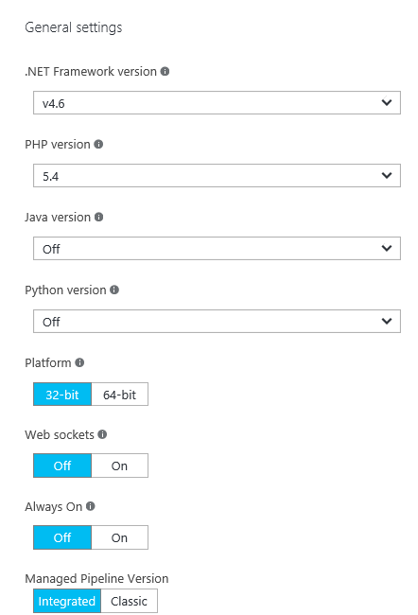
Configuring a web app’s application and authentication settings
Web App settings:
Framework versions
Platform and Web sockets
Always On
Managed Pipeline Version
Auto Swap
Debugging
Certificates, Domain Names, and SSL Bindings
App Settings
Connection Strings
Default Documents
Diagnostic logs
Authentication and Authorization
Notes:
This slide covers many of the settings that appear in a web app’s Settings blade. You can show this blade to students as you talk about each setting. If you do this, skip the monitoring and diagnostic settings, because later topics describe these items.
20533C
5: Implementing Azure App Service

Slide 75
Configuring availability and scalability
Scaling a Free tier web app is not possible
Scaling Shared and Basic tier web apps:
Instance size
Instance count
Scaling Standard and Premium tier web apps:
Instance size
Instance count
Scheduled scaling
Scale by metric
Auto-scaling
Notes:
You will configure most of these options in the next demonstration. While you present this topic, you can show the Settings blade and configure some of its features.
20533C
5: Implementing Azure App Service

Slide 76
Implementing WebJobs
WebJobs are scripts that run:
On demand
Continuously
On a configurable schedule
WebJobs can be:
Batch files (.cmd, .bat)
PowerShell scripts (.ps1)
Bash shell scripts (.sh)
PHP scripts (.php)
Python scripts (.py)
Node.js JavaScripts (.js)
Notes:
Administrators typically use batch files or Windows PowerShell scripts to write script, while administrators with UNIX experience might write Bash shell scripts. Developers typically use the other scripting options that the slide lists.
Ensure that students understand that they must place scripts in a zip file, with any required resources, before they upload them to the Azure portal as a WebJob.
20533C
5: Implementing Azure App Service

Slide 77
Monitoring web apps
Access diagnostic logs by using:
FTP
Windows PowerShell
Azure command-line tools
View logs in Visual Studio by using Application Insight
Monitor web apps in the Azure portal by:
Adding metrics
Configuring alerts
Notes:
20533C
5: Implementing Azure App Service

Slide 78
Creating and configuring mobile apps
The features of mobile apps:
Single sign-on
Offline synchronization
Push notifications
Auto-scaling
WebJobs
Connect to a SaaS API
Virtual network integration
Staging environment
Notes:
20533C
5: Implementing Azure App Service

Slide 79
Configuring authentication
Register with a provider:
Azure Active Directory
Microsoft account
Facebook
Twitter
Google
Configure authentication in the mobile app
Cache the authentication token on the client device
Notes:
Emphasize to the students that users prefer to authenticate with existing accounts instead of creating a new account for your app. For this reason, it is very common to authenticate against common Internet identity providers.
Additionally, explain that developers often hard-code app credentials, such as app keys, into mobile apps, without creating backend mobile apps in Azure. Therefore, by using the Mobile Apps feature, you can enable or disable identity providers without changing your app code.
20533C
5: Implementing Azure App Service

Slide 80
Deploying a mobile app
Using a publish profile:
Download the profile from the Azure portal
Import the profile into Visual Studio
Complete the publishing wizard
Using a Git repository:
Install Git
Create a local repository
Set up the credentials
Configure continuous deployment
Notes:
20533C
5: Implementing Azure App Service

Slide 81
Overview of Traffic Manager
DNS
www.adatum.com IN CNAME
adatum.trafficmanager.net
Traffic Manager
Monitoring
West US
North Europe
Japan West
Web app endpoints
Notes:
20533C
5: Implementing Azure App Service

Slide 82
Traffic Manager best practices
Remember that the Traffic Manager prefix must be unique
Be careful when changing the DNS TTL value
Ensure that all endpoints are in the same subscription
Use only production endpoints
Name endpoints clearly
Make endpoints consistent:
Same web app and port number
Same monitoring settings
Disable endpoints for web app maintenance
Notes:
20533C
5: Implementing Azure App Service

Slide 83
Planning and implementing storage, backup, and recovery services
Notes:
Presentation: 130 minutes
Lab: 60 minutes
After completing this module, students will be able to:
Choose appropriate Microsoft Azure Storage options to address business needs.
Implement and manage Azure Storage.
Improve web application performance by implementing Azure Content Delivery Networks (CDNs).
Protect on-premises systems and Azure virtual machines (VMs) by using Azure Backup.
Describe Azure Site Recovery capabilities.
Required materials
To teach this module, you need the Microsoft PowerPoint file 20533C_06_Source.pptx.
Preparation tasks
To prepare for this module, you should:
Read all of this module’s materials.
Practice performing the demonstrations and labs.
Work through the Module Review and Takeaways section to determine how you will use the information to reinforce student learning and promote knowledge transfer to on-the-job performance.
As you prepare for this class, it is imperative that you complete the labs yourself. This gives you an understanding of how the labs work, as well as the concepts that each lab covers. This enables you to provide meaningful hints to students who might have issues while working in the labs. Furthermore, it will help guide your lecture to ensure that you discuss the concepts that the labs cover.
20533C
6: Planning and implementing storage, backup, and recovery services

Slide 84
Storage as an Azure component
Compute
Networking
Data & Storage
Web & Mobile
Web Apps
Virtual Networks
Mobile Services
Storage
Traffic Manager
DocumentDB
Push Notifications
Virtual Machines
ExpressRoute
Azure SQL
Mobile Engagement
Cloud Services
Load Balancer
StorSimple
Other services
Service Bus Backup
Azure AD
Scheduler
Azure AD
Azure AD DS
Site Recovery
Security Center
Azure AD DS
MFA
Key Vault
MFA
MFA
Notes:
Use this slide to describe the relationship of Azure Storage and storage-related services such as Azure Backup, Azure Site Recovery, and Azure content delivery network to other Azure services. This is the same slide presented in the “Overview of Microsoft Azure” lesson in Module 1. However, the principal subjects of this module, Azure Storage, Azure Backup, Azure Site Recovery, and Content Delivery Network, are highlighted. Closely related subjects are also highlighted, infrastructure as a service (IaaS) V1 and V2 virtual machines.
20533C
6: Planning and implementing storage, backup, and recovery services

Slide 85
Overview of Azure Storage
Storage account:
URL
Location
Replication scope:
Locally redundant
Zone-redundant
Geo-redundant
Geo-redundant with read-only access to a secondary region
Storage types:
Blob storage - containers for data blobs
Table storage - nonrelational key/value records
Queue storage - asynchronous messages
File storage - SMB 3.0 file shares
Notes:
Emphasize that a standard storage account represents a namespace that identifies a storage area, which can include blob, table, queue, and file storage for standard storage accounts. Point out that premium storage accounts allow for hosting page blobs only.
This lesson later compares the storage types that Azure Storage supports. The last topic of this lesson covers premium storage accounts in more detail.
20533C
6: Planning and implementing storage, backup, and recovery services

Slide 86
Planning for standard Azure Storage
Blob storage:
Block blobs - variable-sized blocks, optimized for large blobs
Page blob - 512-byte pages, optimized for random read/write
Append blob - specifically for append operations
Table storage:
Stores data as key/value pairs in rows
Row entities or 252 custom properties (columns)
Single clustered index
Queue storage:
Stores inter-application messages
File storage:
SMB 3.0 file shares
Notes:
This slide offers the basic capabilities of each storage option, but Azure offers more nuanced criteria for selecting a storage option. Application developers will have multiple requirements, which will affect storage choice. The choices include many storage options beyond Azure Storage:
Blobs:
Use block blobs for applications that need to upload large files to Azure. Block blobs are optimized for fast uploads and high throughput.
Use page blocks for applications that need to read and write data by using random I/O access patterns. For example, Azure VMs use page blobs to store virtual hard disks.
Tables:
Use tables as a NoSQL store for key/value pair records.
Queues:
Use queues to implement applications that need to store a backlog of asynchronous tasks or to enable asynchronous service-to-service messages. Note that many application developers use the newer Azure Service Bus service instead of Azure Queue storage.
Files:
Use the Azure File Service to create file shares in Azure storage that users can access by using standard Server Message Block (SMB) semantics from VMs in Azure and from on-premises locations via a site-to-site virtual private network (VPN) or ExpressRoute.
20533C
6: Planning and implementing storage, backup, and recovery services

Slide 87
Planning for Azure Premium Storage
DS or GS virtual machine
Blobcache
RAM cache
Server SSD cache
Azure storage page blobs
Notes:
Point out the main differences between standard and premium storage accounts. In addition to the supported storage service types that the overview of Azure storage mentioned, note the different billing models. With Premium Storage, you pay for provisioned capacity rather than used capacity, which is applicable to standard storage accounts. On the other hand, Premium Storage does not incur separate charges for transactional volume.
20533C
6: Planning and implementing storage, backup, and recovery services

Slide 88
Storage access tools
REST APIs and Client Libraries
Azure PowerShell
AzCopy
Azure Storage Explorer (CodePlex)
Server Explorer (Visual Studio 2015)
Notes:
20533C
6: Planning and implementing storage, backup, and recovery services

Slide 89
Creating a storage account
Specify a unique name:
3 – 24 characters
Contains only lowercase letters and digits
Choose a redundancy level and type:
Locally redundant storage (Premium or Standard)
Zone-redundant storage (standard – block blobs only)
Geo-redundant Storage (standard)
Read-access – geo-redundant storage (standard)
Generates:
Primary and secondary access keys
Blob, Queue, Table, and File service endpoints
Premium page blobs only, zone-redundant block blobs only
Notes:
20533C
6: Planning and implementing storage, backup, and recovery services

Slide 90
Implementing blobs
Create a container in a storage account
Specify an access level:
Private
Public Blob
Public Container
Manage by using:
AzCopy
Azure Storage Explorer
Azure PowerShell
Azure portal
Notes:
20533C
6: Planning and implementing storage, backup, and recovery services

Slide 91
Implementing Azure file storage
Creating file shares:
Azure portal, Windows PowerShell, or REST API
Accessing file shares:
Map a drive with the net use command (provide an account name and a key) from the same region or a remote Azure region, or from an on-premises in a hybrid scenario
Alternatively, use Windows PowerShell, AzCopy, or the REST API
Notes:
Point out that Azure files allow shared access to files.
20533C
6: Planning and implementing storage, backup, and recovery services

Slide 92
Implementing Azure table and queue storage
Create and update programmatically by applications
Manage by using:
Azure Storage Explorer
Azure PowerShell:
Tables:
Queues:
New-AzureStorageTable –Name $tabName –Context $context
Get-AzureStorageTable –Name $tabName –Context $context
Remove-AzureStorageTable –Name $tabName –Context $context
New-AzureStorageQueue –Name $qName –Context $context
Get-AzureStorageQueue –Name $qName –Context $context
Remove-AzureStorageQueue –Name $qName –Context $context
Notes:
20533C
6: Planning and implementing storage, backup, and recovery services

Slide 93
Controlling access to storage
Storage account access keys:
Primary and secondary
Automatically generated but can be recycled
Provide full access to a storage account
SAS:
Granular (container or resource level)
Time-limited
Stored access policy:
Granular (container level)
Time-limited
You can easily revoke policy-linked SAS
Role-based access control:
Default roles
Custom roles
Notes:
Point out that you can use a combination of access control mechanisms.
Note that shared access signatures that do not rely on a shared access policy typically are known as ad hoc shared access signature.
20533C
6: Planning and implementing storage, backup, and recovery services

Slide 94
Monitoring storage
You can enable monitoring for a new or existing standard storage account:
Aggregate metrics
Per-API metrics
Logs
Not supported for Azure Premium storage accounts
Metrics and logs are stored in the same storage account
Metrics can be displayed in the Monitoring lens
Metric-based alerts:
Delivered through email
Routed to a Webhook
Notes:
20533C
6: Planning and implementing storage, backup, and recovery services

Slide 95

Overview of CDNs
Azure storage
account
in Europe
Content
Seattle
POP
New
York
POP
Paris
POP
Seoul
POP
Tokyo
POP
Client in
South Korea
Notes:
Explain that to improve the web customer experience, CDNs provide low latency and high speed when accessing static web content. This is achieved by caching content in globally distributed locations and directing customer requests to the closest one.
Point out that Azure content delivery networks support HTTPS calls, allowing you to integrate content from a CDN into secure webpages.
20533C
6: Planning and implementing storage, backup, and recovery services

Slide 96
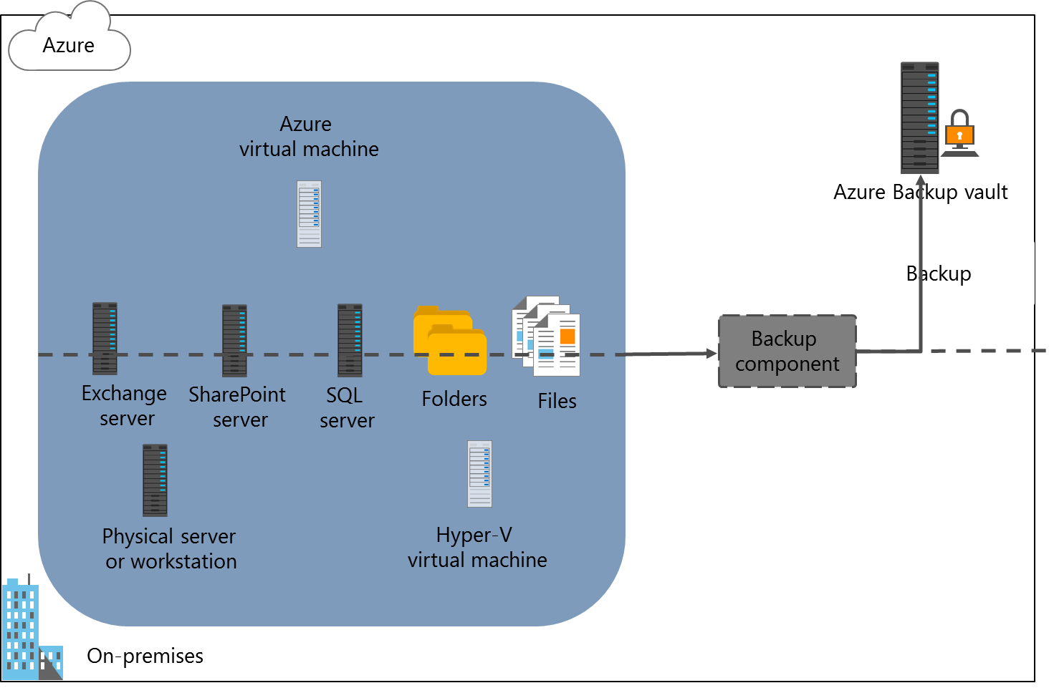
Overview of Azure Backup
Notes:
If still applicable, point out that Azure Backup management is available only on the Azure classic portal or through Azure PowerShell. While the Azure Backup service is included on the Azure portal, at the time of writing this course, this interface only allows you to create Azure Backup vaults.
Students will implement Azure Backup agent–based protection in the lab.
20533C
6: Planning and implementing storage, backup, and recovery services

Slide 97
File and folder backups with the Azure Backup agent
Create an Azure Backup vault
Download the vault credentials
Download and install the Azure Backup agent
Register the computer with the vault and set the password
Configure the initial backup type, choose files and folders to back up, and then create a backup schedule
Notes:
Point out that the Azure Import/Export service options integrate into the Choose Initial Backup Type page of the Schedule Backup Wizard of the Azure Backup console.
20533C
6: Planning and implementing storage, backup, and recovery services

Slide 98
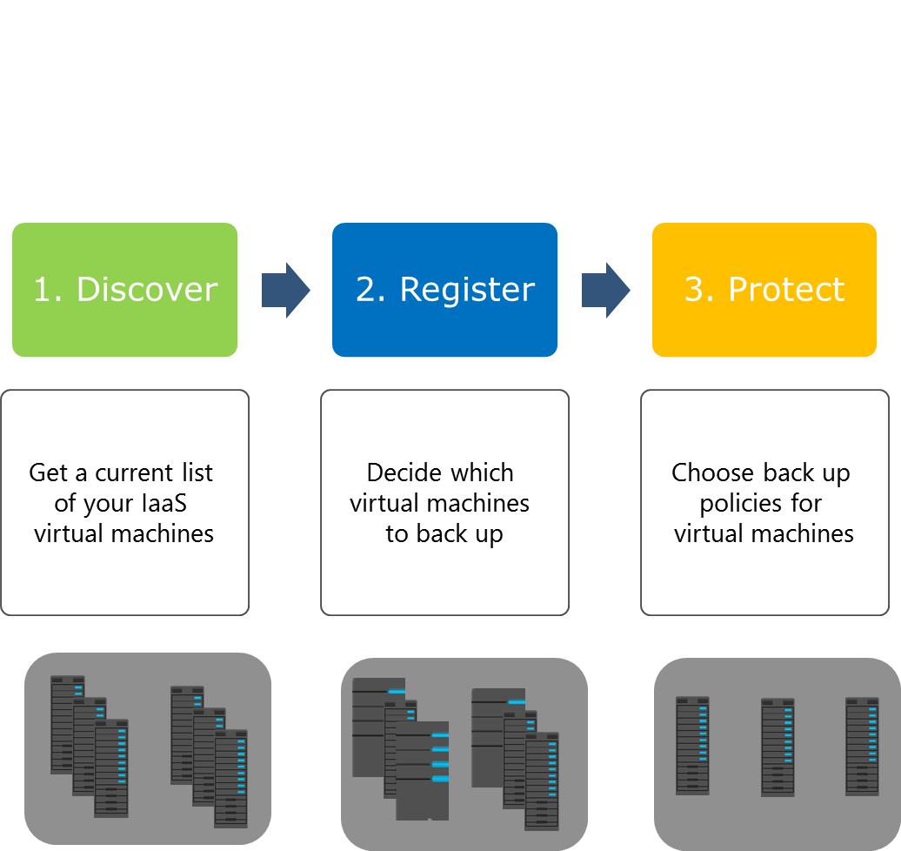
VM-level backup by using the Azure Backup VM extension
Notes:
20533C
6: Planning and implementing storage, backup, and recovery services

Slide 99
Integrating Azure Backup with Data Protection Manager and Microsoft Azure Backup Server
Feature | System Center 2012 DPM | Azure Backup Server
Application workloads | Yes | Yes
Tape backup | Yes | No
Integration with System Center suite | Yes | No
System Center licensing required | Yes | No
Deduplication support | Yes | Yes
Notes:
20533C
6: Planning and implementing storage, backup, and recovery services

Slide 100
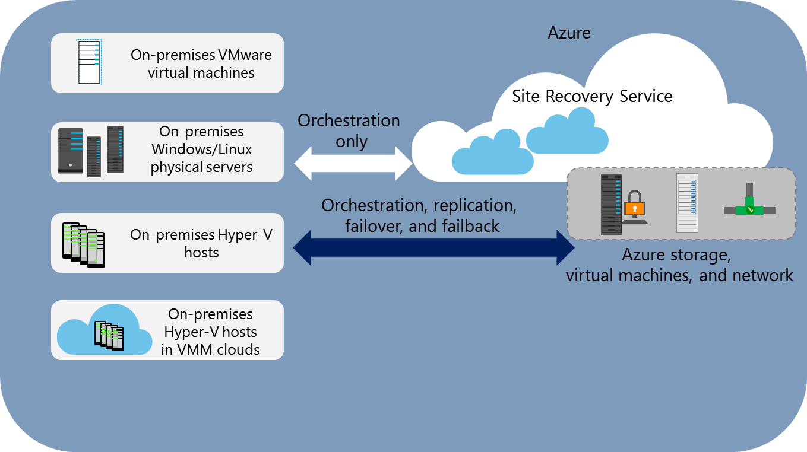
Overview of Azure Site Recovery
Notes:
20533C
6: Planning and implementing storage, backup, and recovery services

